Slide 1



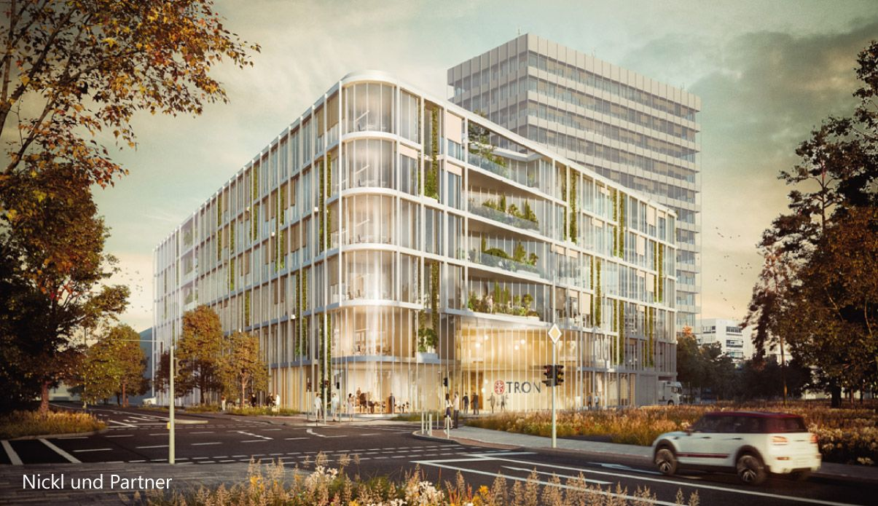
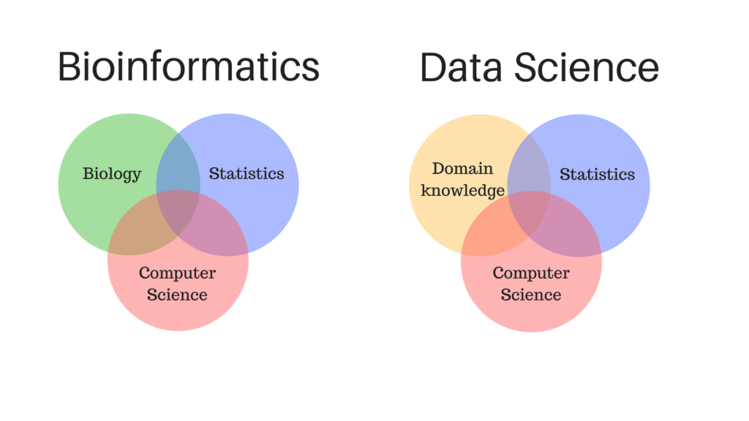
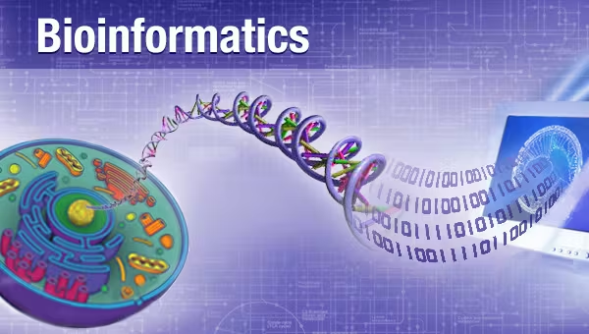
Introduction to Bioinformatics
Study program: Bioprocess Engineering
Elective Module (Wahlpflichtmodul)
9th October to 13th October
Responsible: Prof. Dr. Axel Blokesch, blokesch@fb2.fra-uas.de
by Pablo Riesgo-Ferreiro, TRON gGmbH
pablo.riesgoferreiro@tron-mainz.de
Day 2 - Session 2

Slide 2
Outline of session
Package managers and virtual environments
Workflow managers
Nextflow tutorial

Slide 3
Package managers
... and virtual environments

Slide 4
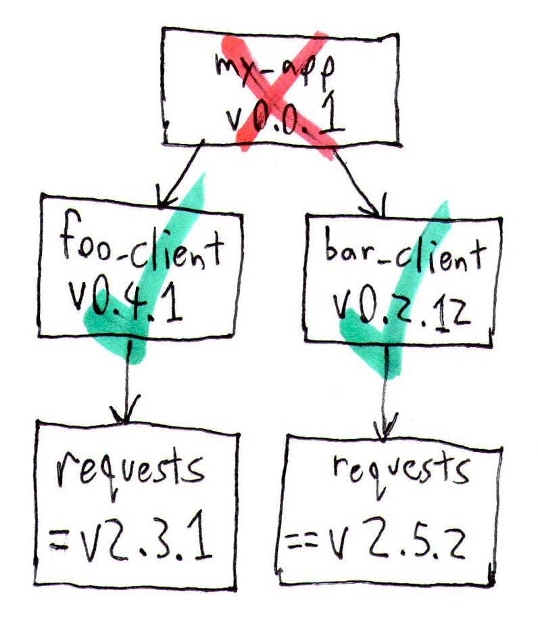
Motivation of package managers
Facilitate installation of dependencies
Automate management of the dependency tree
Avoid dependency hell
Source: https://medium.com/knerd/the-nine-circles-of-python-dependency-hell-481d53e3e025

Slide 5
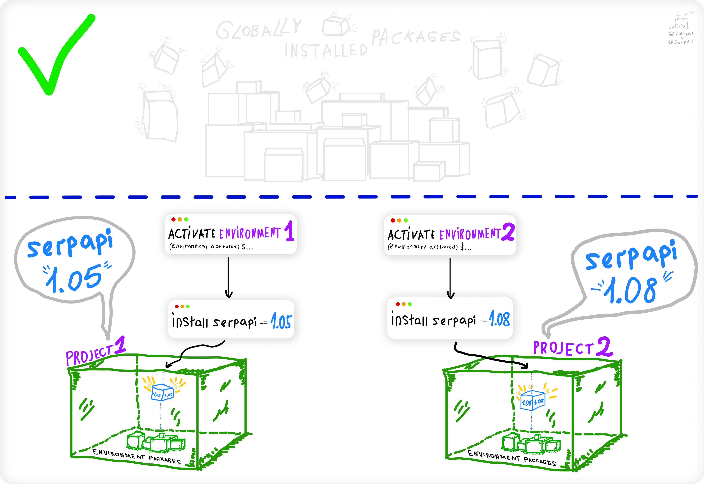
Motivation of virtual environments
Avoid collisions between the dependencies of multiple development projects
Decentralize dependency management
Enforce reproducibility and traceability of results
Enable experimentation with new libraries without unwanted side effects
Source: https://serpapi.com/blog/python-virtual-environments-using-virtualenv-and-poetry/

Slide 6
Motivation of virtual environments (dramatized)
We want to avoid this situation illustrating a collision in a centralized environment
>>> User_1: dear admin, I need library X upgraded to version 2.0.0
>>> Admin: done
>>> User_1: thanks!
[… time goes by…]
>>> User_2: why is this not working when it used to work?
[… more time goes by during which User_2 may have lost some hair…]
>>> User_2: dear admin, I just found out that my code needs library X version 1.0.0 can you downgrade it?
Alternative 1
>>> Admin: Errrrrr… can you upgrade your code?
Alternative 2
>>> Admin: done
[… now User_1 may lose some hair…]

Slide 7

What is a virtual environment
A layer of isolation on top of the Python interpreter
As per the documentation
“a self-contained directory tree that contains a Python installation for a particular version of Python, plus a number of additional packages.”
The aim is to enable having multiple Python environments in the same machine that are isolated from each other
Implementations in Python:
virtualenv. Popular package to create Python virtual environments
pipenv. Improved virtualenv
conda. Equivalent of virtualenv in the anaconda environment
pyvenv. Built in into Python >= 3.3, deprecated in Python 3.6 on behalf of venv
pyenv. Aims at virtualizing the Python interpreter version. Out of scope
For the rest of this talk we will focus on virtualenv
Analogy to Docker
Docker virtualizes the whole OS, while virtualenv virtualize Python
Source: https://realpython.com/python-virtual-environments-a-primer/

Slide 8
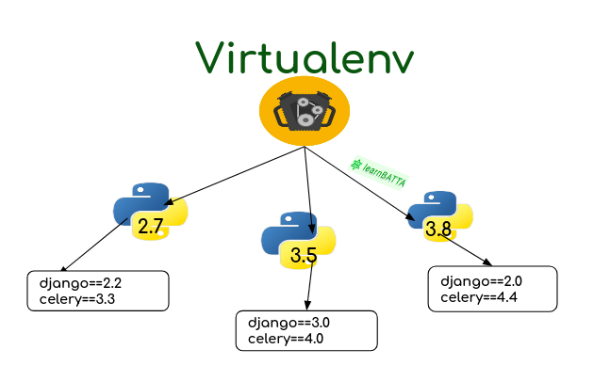
How do virtual environments help?
Enabling the use of different library versions in the same machine
Enabling testing on different versions of the Python interpreter
Reasonable footprint
A plain vanilla virtual environment is 27 MB
A virtual environment with lots of data analysis dependencies goes up to 1 GB
No admin permissions required
Freedom! Use it with care!
Upgrading a library in a virtual environment does not have any side effects on other virtual environments
Virtual environments document the libraries used for a particular analysis, enabling reproducibility and traceability of results
Source: https://learnbatta.com/blog/how-to-install-python-virtualenv-19/

Slide 9
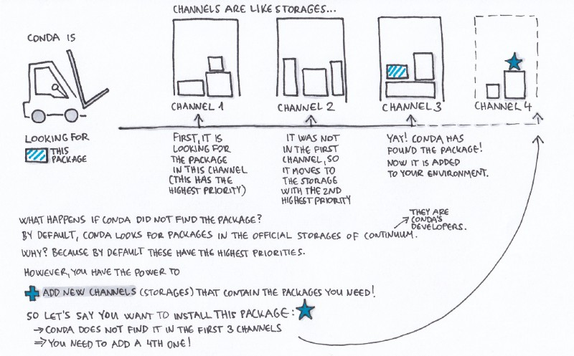
Conda, anaconda, mamba, micromamba
Conda: „Package, dependency and environment management for any language—Python, R, Ruby, Lua, Scala, Java, JavaScript, C/ C++, Fortran, and more.Enabling testing on different versions of the Python interpreter“
Mamba is a faster reimplementation of conda in C++
Anaconda is a full data science platform based on conda
Miniconda is a minimal conda distribution
Micromamba is a minimal mamba distribution
All of the previous work with channels, which are repositories of software packages
conda-forge is a very popular general purpose channel
bioconda is a popular channel for bioinformatics packages (https://github.com/bioconda)
Source: https://www.freecodecamp.org/news/why-you-need-python-environments-and-how-to-manage-them-with-conda-85f155f4353c/

Slide 10
Workflow managers

Slide 11
Motivation
More granularity to define requirements of computational resources
Auditing of pipelines performance and resource utilisation
Improve resource utilisation
Parallelization => improved performance
Transparent parallelization of concurrent tasks
Support for implementation of embarrassingly parallel tasks
Parallelization across multiple machines
Reduce code for orchestration of tasks => faster development
Rexecutions and partial rexecutions => ease operations
Reproducibility => avoid potential FP and FN
Different users
Different hardware/software
Numerical stability

Slide 12
How does the ideal workflow manager give you that?
Seamless integration with HPC batch schedulers, eg: slurm
Domain Specific Language (DSL) for orchestration of tasks
Directed Acyclic Graph (DAG) of tasks and dynamic branch evaluation
Partial rexecutions for failed workflows and workflow versioning
Debugging of workflows
Detailed execution statistics to audit workflow performance
Hardware virtualization using docker or singularity

Slide 13
The workflow engine magic
Input A
Output B
Input A
Output B
Input A
Output C
Input A
Output C
Input B
Output D
Input B
Output E
Workflow engine
Input B
Output D
Input B
Output E
Input DE
Output F
C
Input DE
Output F
F

Slide 14
Some implementations and standards
Galaxy
Pros: visual interface ; cons: their target users are non bioinformaticians
Common Workflow Language (CWL)
Pros: supported by many, community effort, some very good ideas; cons: far too complex, inflexible
https://www.commonwl.org/
GA4GH working groups
Pros: GA4GH have a lot of traction with academia and industry; cons: slow and few committed individuals
Cloud Work Stream are developping the Workflow Execution Service API https://github.com/ga4gh/workflow-execution-service-schemas and the Task Execution Schemas https://github.com/ga4gh/task-execution-schemas
SnakeMake
Pros: DSL supporting bash and Python; cons: DAG is not dynamic, integration with slurm is “hacky”
Köster, J., & Rahmann, S. (2012). Snakemake-a scalable bioinformatics workflow engine. Bioinformatics, 28(19), 2520–2522. https://doi.org/10.1093/bioinformatics/bts480
Luigi
Pros: implemented by Spotify, Python-based, GUI, debugging; cons: no DSL
https://github.com/spotify/luigi and https://github.com/pharmbio/sciluigi
Lampa, S., Alvarsson, J., & Spjuth, O. (2016). Towards agile large-scale predictive modelling in drug discovery with flow-based programming design principles. Journal of Cheminformatics, 8(1), 1–12. https://doi.org/10.1186/s13321-016-0179-6

Slide 15

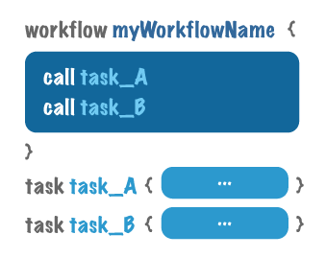
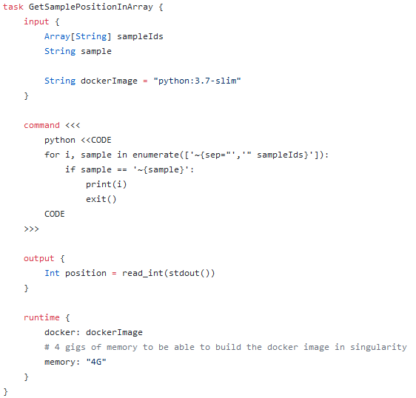
Workflow Definition Language (WDL) and Cromwell
Pros: expressive DSL, wide support from the community, existing pipelines, GUI that holds data of every execution, exposes a REST API for programmatic use, server and standalone architecture, the logo!
Cons: only bash, no scripting within the workflow definition
http://www.openwdl.org/
https://cromwell.readthedocs.io/en/develop/
Repository of existing workflows: https://github.com/biowdl
Implemented at the Broad Institute

Slide 16
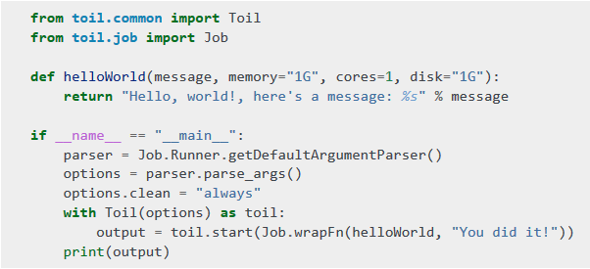

Toil
Pros: workflows implemented with a Python API, also supports CWL and WDL support is in alpha
Cons: no bash support, no DSL other WDL...
Vivian, J., Rao, A. A., Nothaft, F. A., Ketchum, C., Armstrong, J., Novak, A., … Paten, B. (2017). Toil enables reproducible, open source, big biomedical data analyses. Nature Biotechnology, 35(4), 314–316. https://doi.org/10.1038/nbt.3772
Implemented at the UCSC

Slide 17
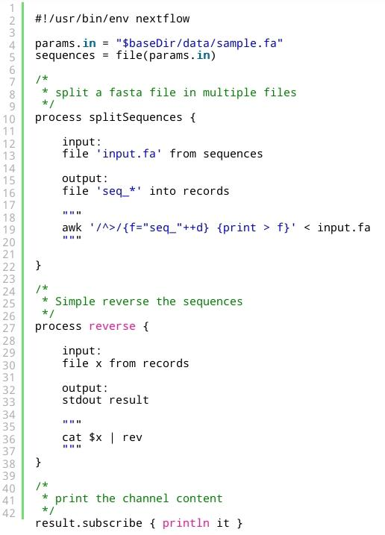

Nextflow
Pros: expressive DSL, greatest flexibility combining Groovy scripting within workflow definition and running polyglot commands, NF-core community, amazing documentation
Cons: risks being replaced by a standard, no modularity at the moment although it is in development
Di Tommaso, P., Chatzou, M., Floden, E. W., Barja, P. P., Palumbo, E., & Notredame, C. (2017). Nextflow enables reproducible computational workflows. Nature Biotechnology, 35(4), 316–319. https://doi.org/10.1038/nbt.3820
Implemented at the CRG (Centre de Regulacio Genomica)

Slide 18
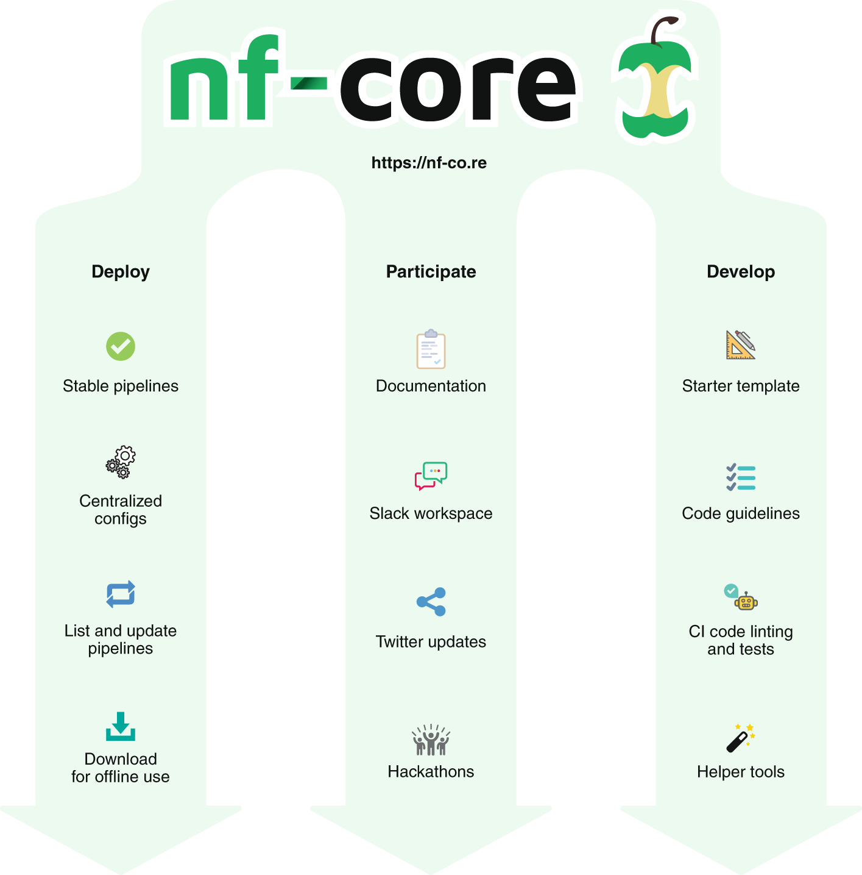
NF-core community
Open source community that can be joined by anyone interested
Provide resources and templates to develop bioinformatics pipelines
The only requisite to create a new pipeline under NF-core is that there is not one already that does the same thing. If this is the case, you are encouraged to join efforts with others in the existing pipeline
Ewels, P.A., Peltzer, A., Fillinger, S. et al. The nf-core framework for community-curated bioinformatics pipelines. Nat Biotechnol 38, 276–278 (2020). https://doi.org/10.1038/s41587-020-0439-x

Slide 19
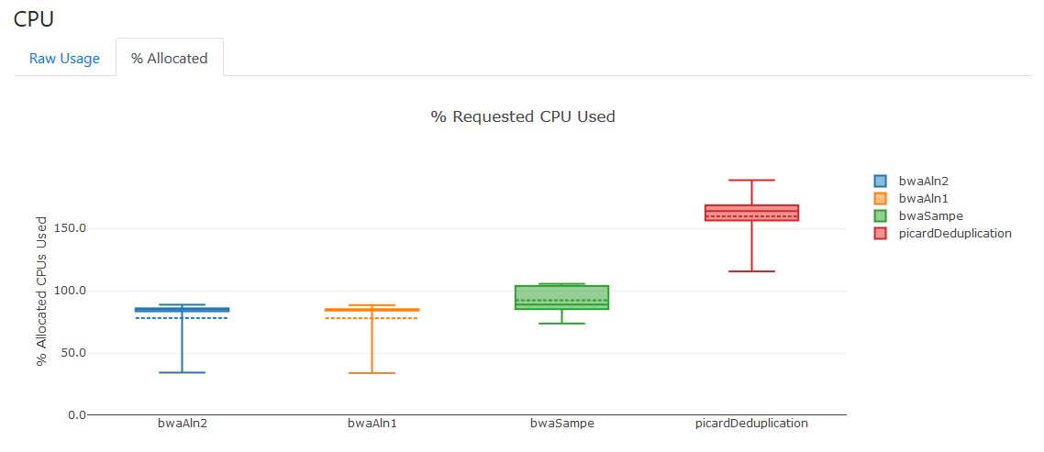
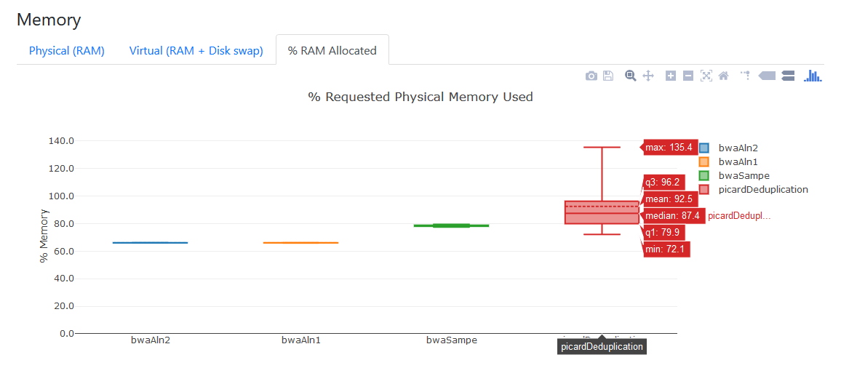
Nextflow - auditing a BWA+deduplication workflow

Slide 20
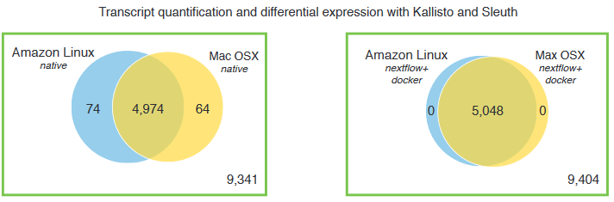
Reproducibility and numerical stability
Different platforms with different floating point implementations may lead to different results
Virtualization solutions. Docker and singularity
Repositories of docker images
https://biocontainers.pro/#/
Private images can be served through solutions like artifactory https://jfrog.com/artifactory/

Slide 21
Nextflow tutorial
https://github.com/TRON-Bioinformatics/tronflow/tree/master/tutorial

